Slide 1
FACIAL DISTORTION

Slide 2
Learning Objective
Today we are learning about Facial Distortion in art.

Slide 3
Learning Tasks:
We will research COLLAGE art works by Hilda Hilst, John Stezaker, Wes Naman, and Lola Dupre.
Can we create our own FACIAL DISTORTION COLLAGE in the style of these artists?

Slide 4
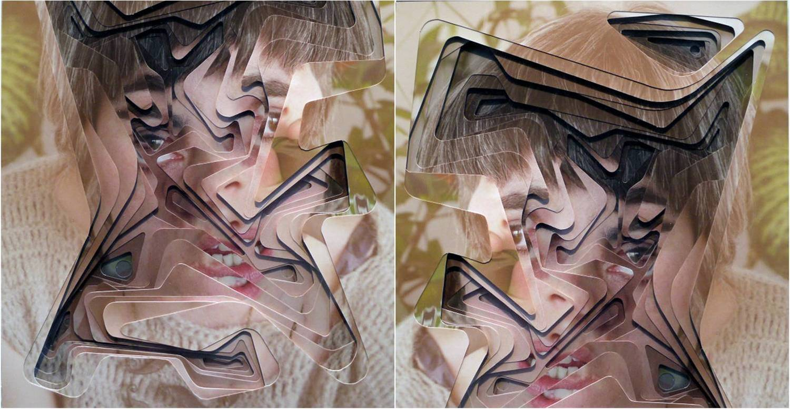
Hilda Hilst

Slide 5
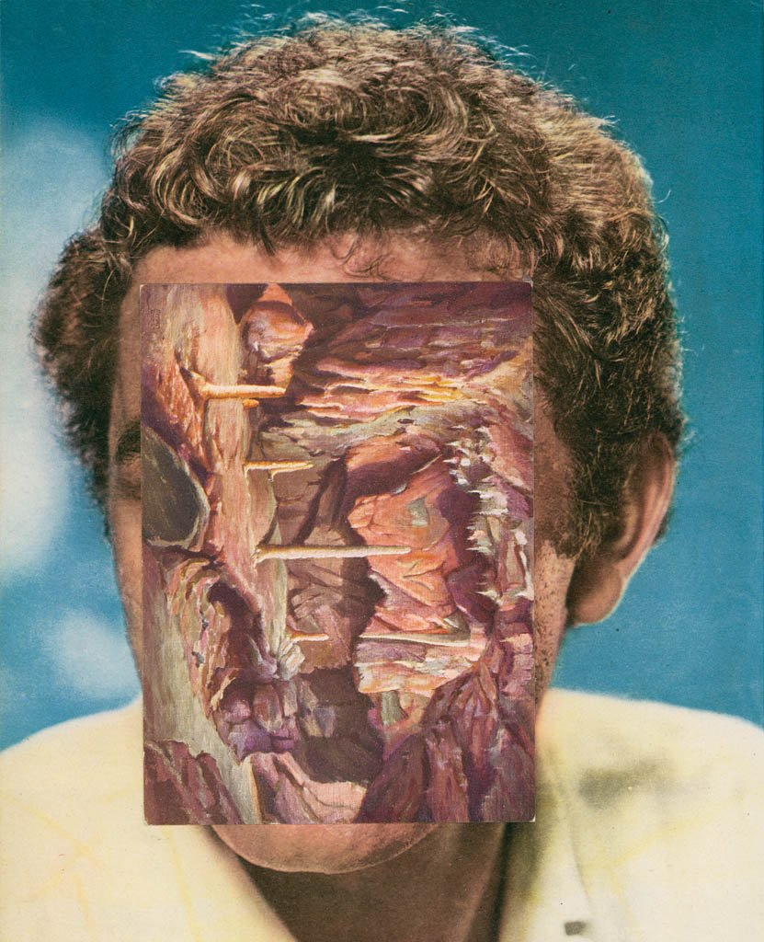
John Stezaker

Slide 6
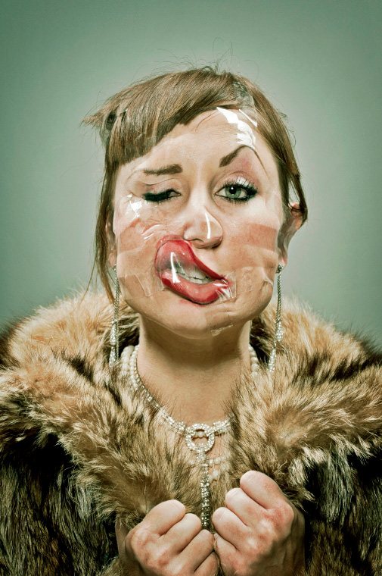
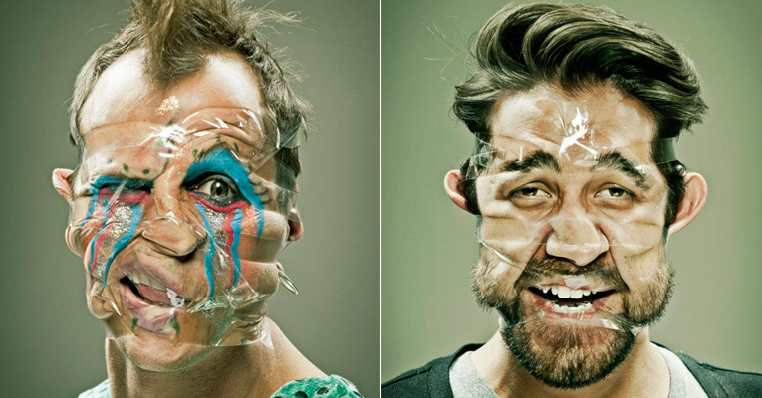
Wes Naman

Slide 7
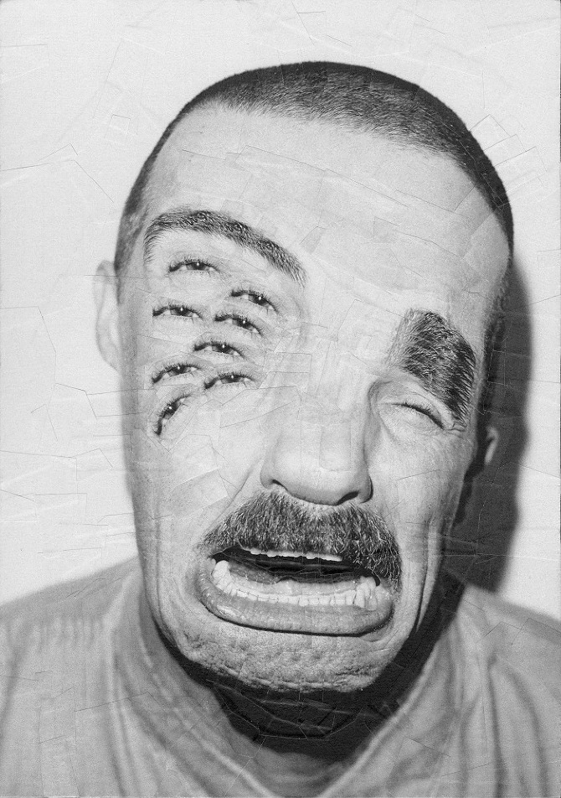
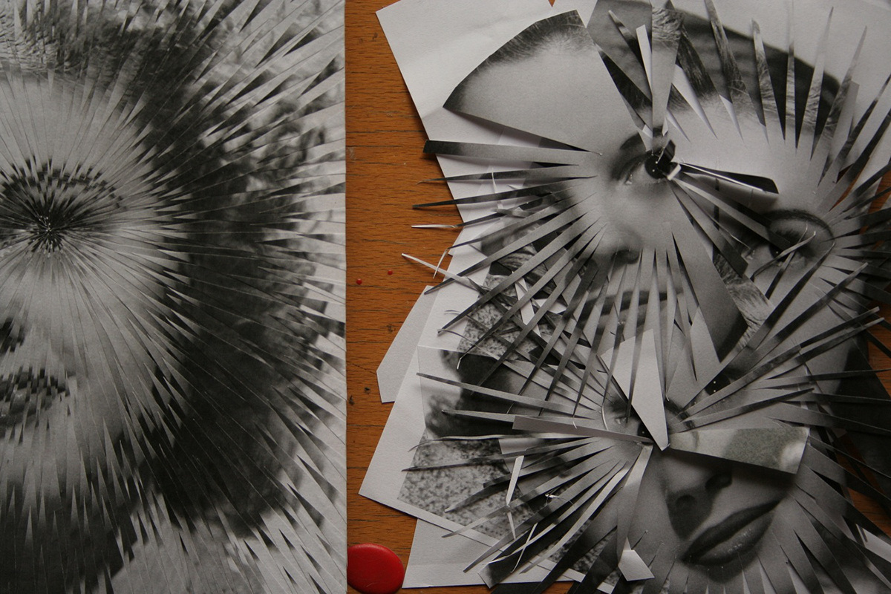
Lola Dupre

Slide 8
Collage Task 1:
Research COLLAGE art works by Hilda Hilst, John Stezaker, Wes Naman, and Lola Dupre.
Create a PowerPoint slide for each of these artists and try and write about the techniques used.
Do you think the work is successful? Is the work humorous? Does the work inspire you to try a facial portrait?
(WRITE IN YOUR OWN WORDS, NOT CUT AND PASTE!)

Slide 9
Task 2:
Can we create our own FACIAL DISTORTION COLLAGE in the style of these artists?

Slide 10
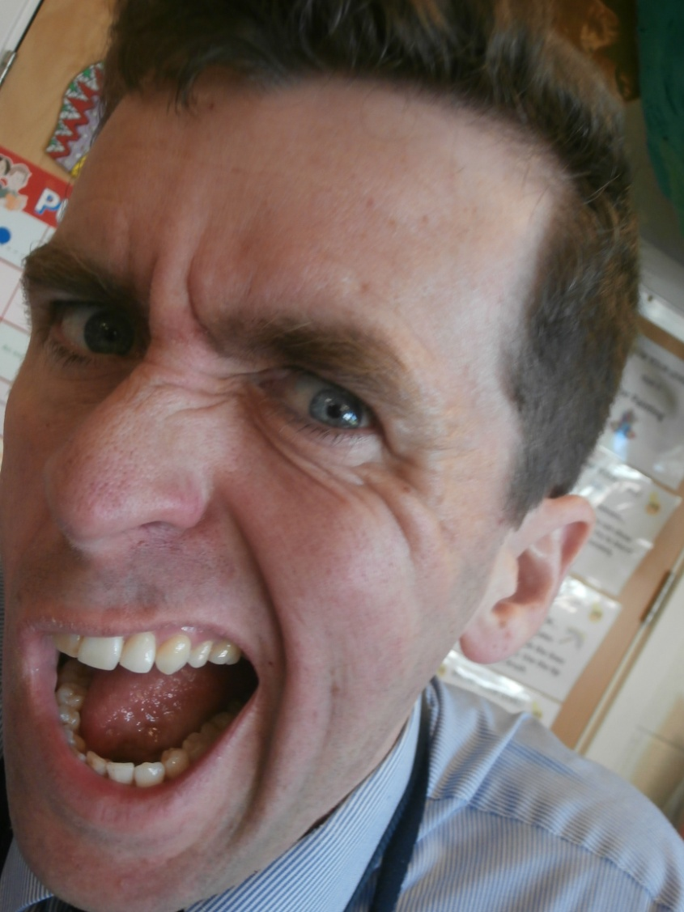
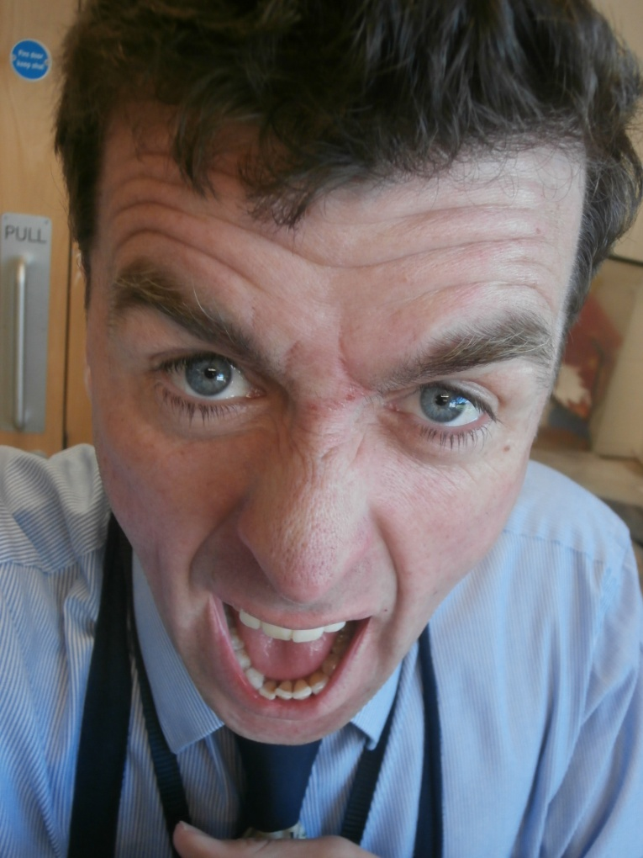
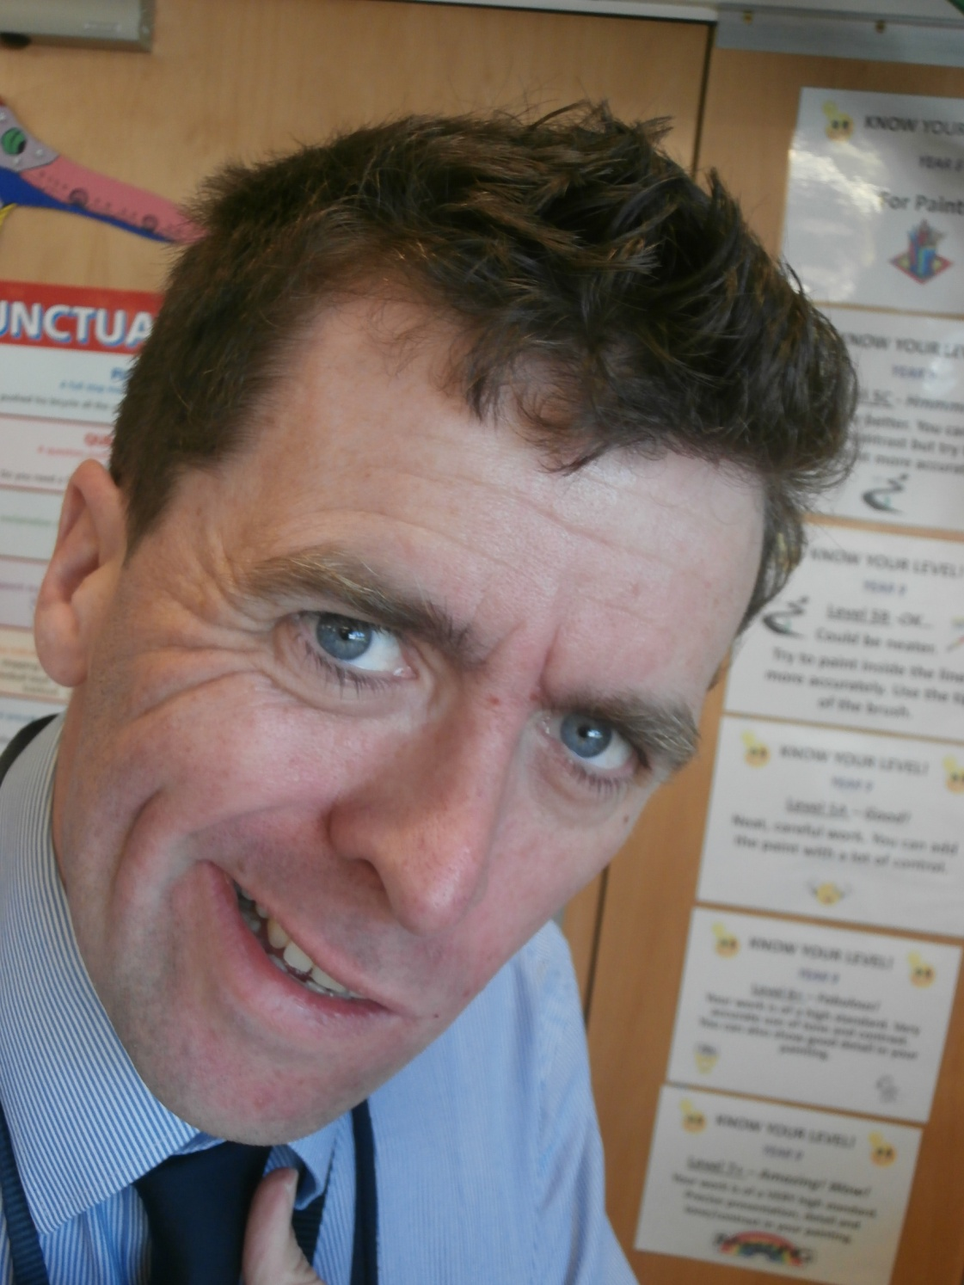
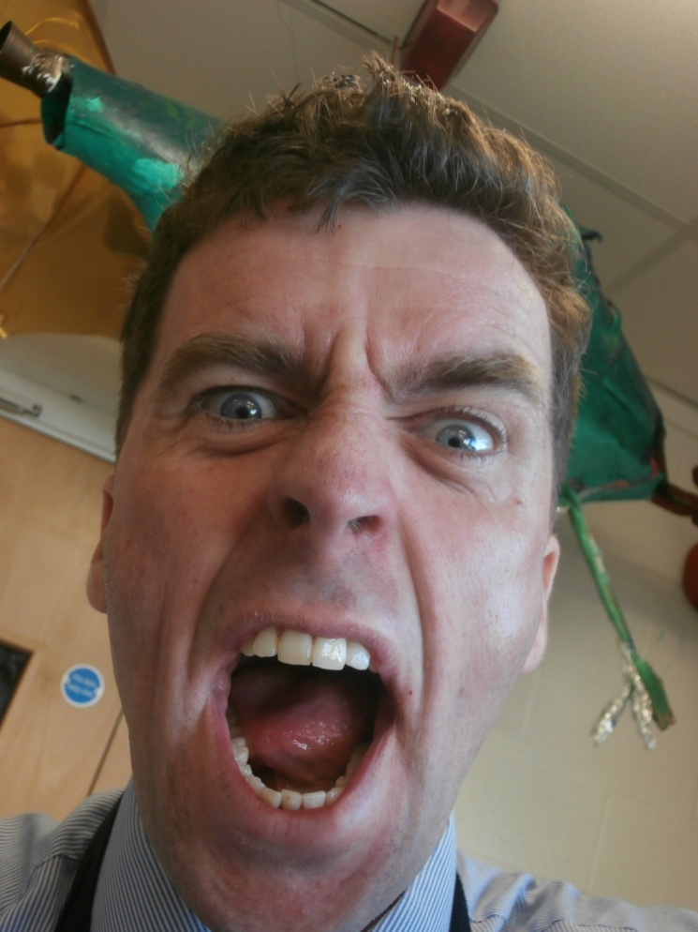

Slide 11
1. Print out the 4 photographs of Mr. Willans, Art teacher at Chapel Support Centre.
2. Using scissors, CAREFULLY cut out different facial features (eyes, nose. Mouth etc.) from each photograph.
3. Stick down and collage one large distorted face of Mr. Willans in the style of our FACIAL DISTORTION artists!
4. Once the collage is complete, try and write about your collage. Is it successful? Does it have humour?

Slide 12
WWW
EBI

