Slide 1
THE FACE Self(y) portrait

Slide 2
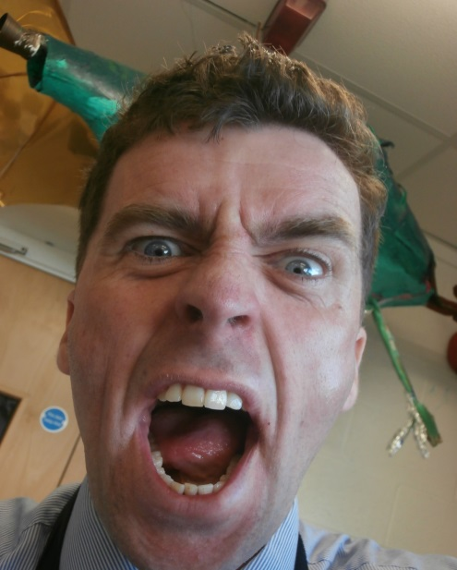
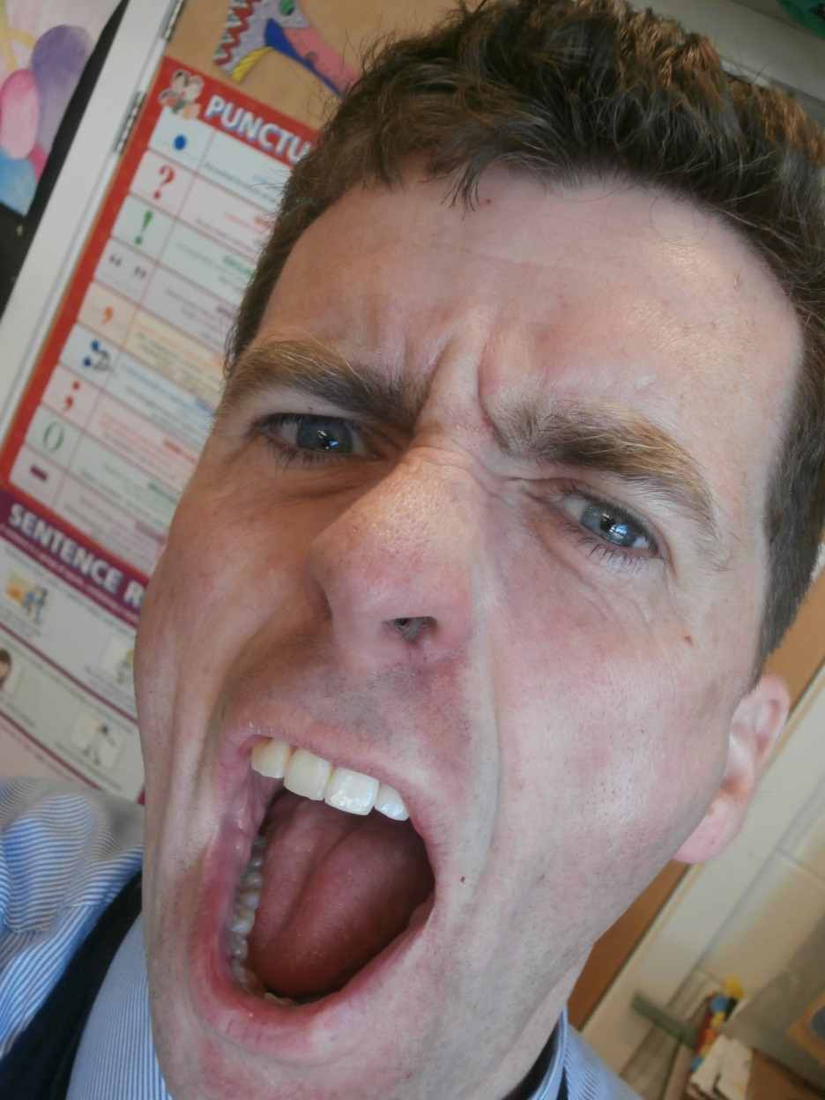
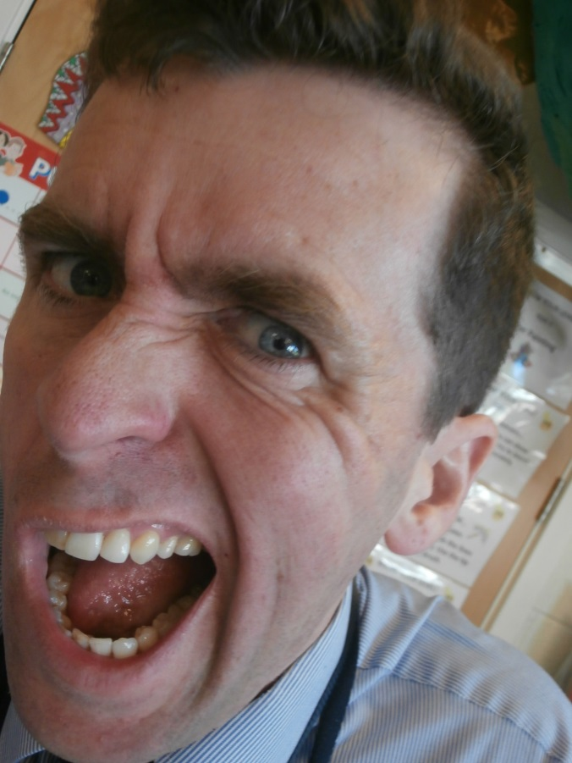
LAST TIME WE MADE A DISTORTED FACE COLLAGE…

Slide 3
TODAY

Slide 4
LO 1: Can we create a self-portrait that has both realistic and stylised elements?
LO 2: To demonstrate the portraiture and graffiti skills you have learned so far this year in Art.

Slide 5
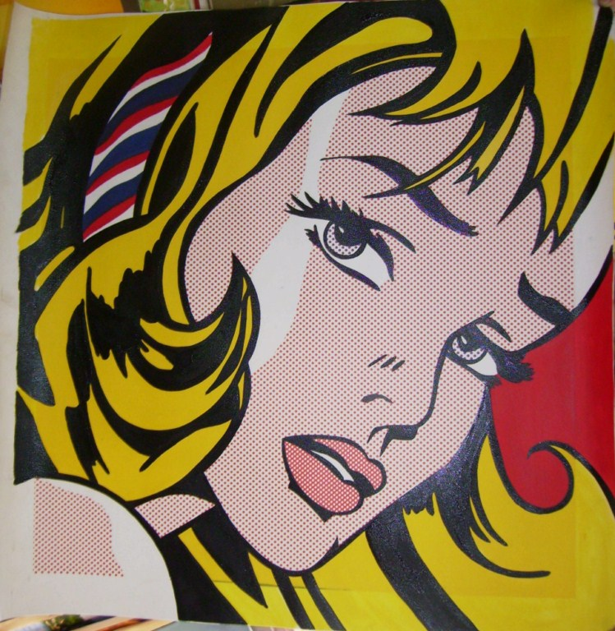
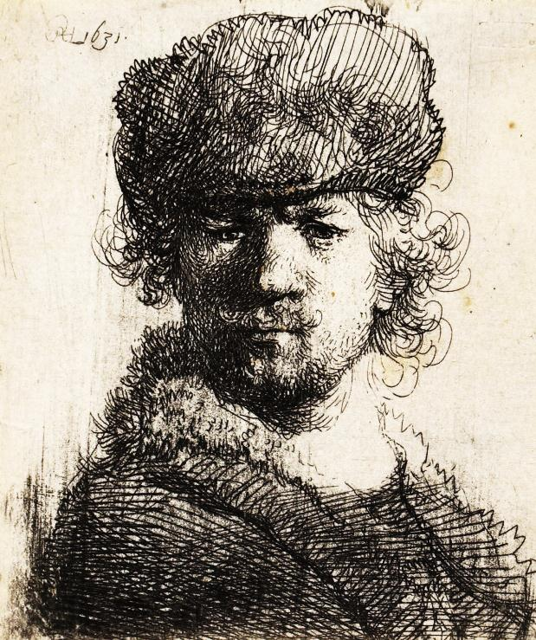
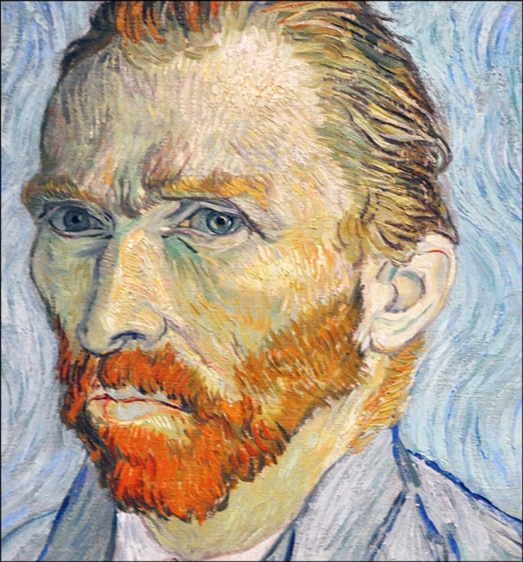
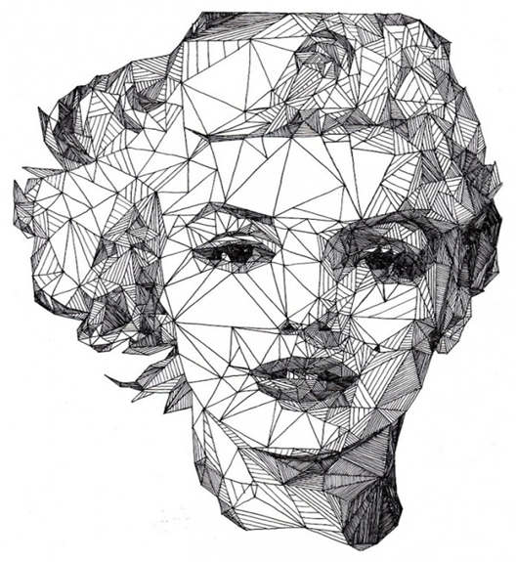
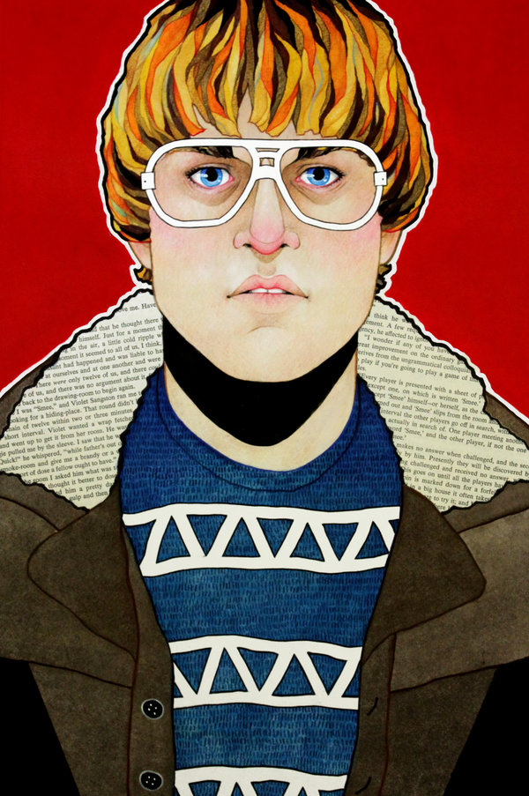
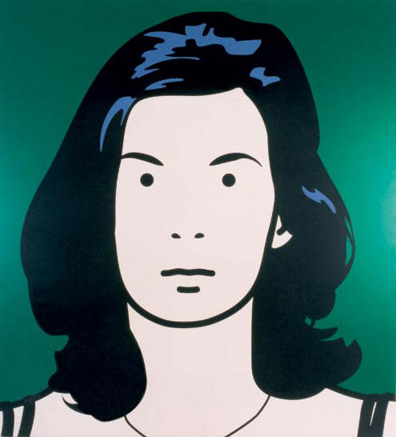
Create a self-portrait with style

Slide 6
FACE
Whoever we are, we all have a FACE.
Me, you, the Prime Minister, your Mum, my Mum.
Rich people, poor people, famous people, everyday people all over the world, from prehistoric humans to mankind today…

Slide 7
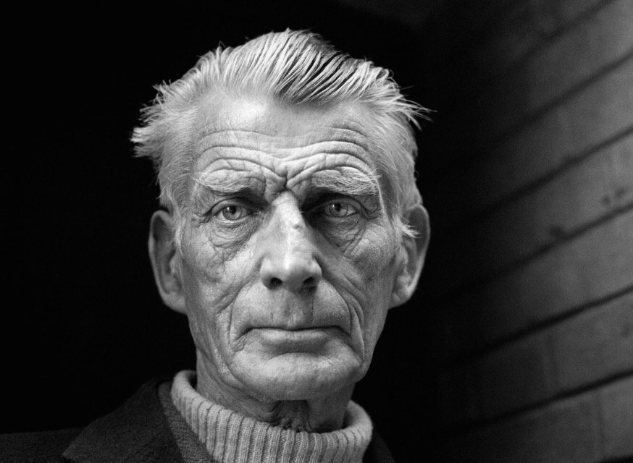
...but can YOU draw your face?

Slide 8
SELF PORTRAIT TIPS
Use a mirror to lightly sketch out your face (an egg shape).
Halfway down the outline egg shape, lightly draw a line horizontally across (this will be your eye line).

Slide 9
3. Then lightly draw a vertical line down your face/ egg shape (this line will guide your hand when adding in facial details – nose, mouth etc.
4. Once your facial details are pencilled in and look right, add shade and tone (shading).

Slide 10
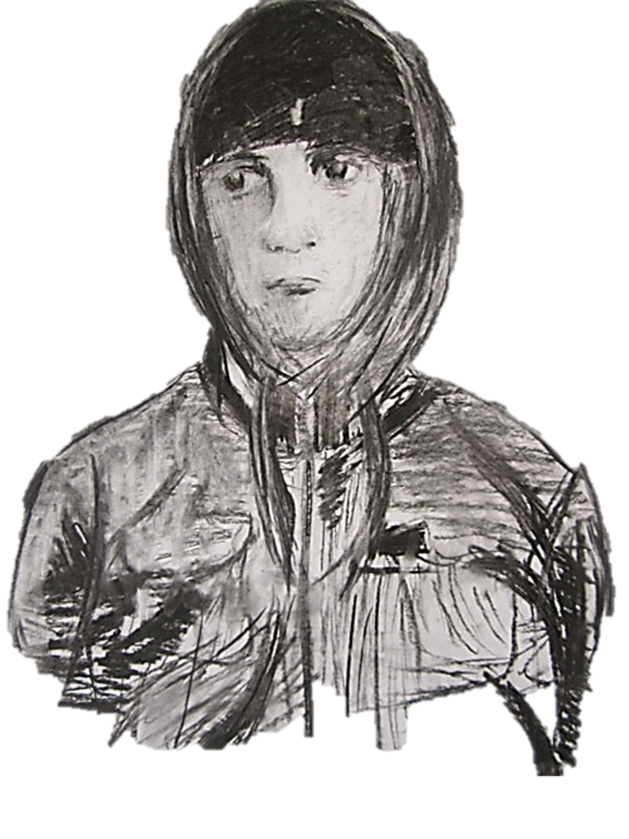
Then, add realistic and stylised elements (hats, coats, things that make you YOU).

Slide 11
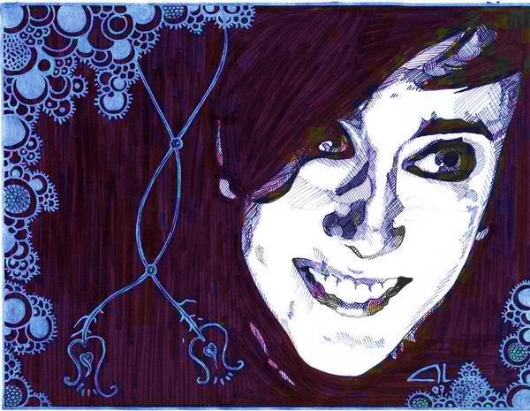
TIP: Draw over pencil lines with a fine liner pen. This will create a BOLD portrait.

Slide 12
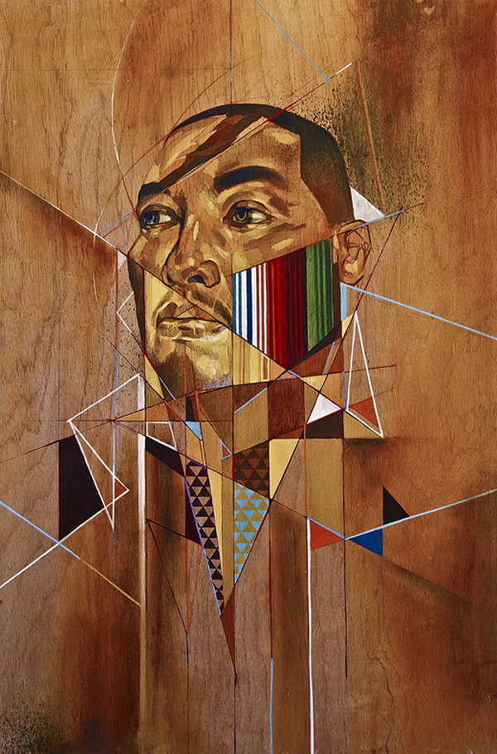
Then, let your creativity run WILD! We can develop your self portrait in many ways – here we have a painting that has a mathematical composition (layout). It is both realistic and stylised.

