Slide 1
STREET ART
YR 10 ART

Slide 2
LESSON 2
Last week, we learnt about the work of American street artist Sheperd Fairey.

Slide 3
ARTIST RESEARCH
IS VERY IMPORTANT AND EVEN FASCINATING IN ART GCSE/ BTEC/ ALEVEL/ DEGREE LEVEL PROJECTS AND BEYOND!

Slide 4
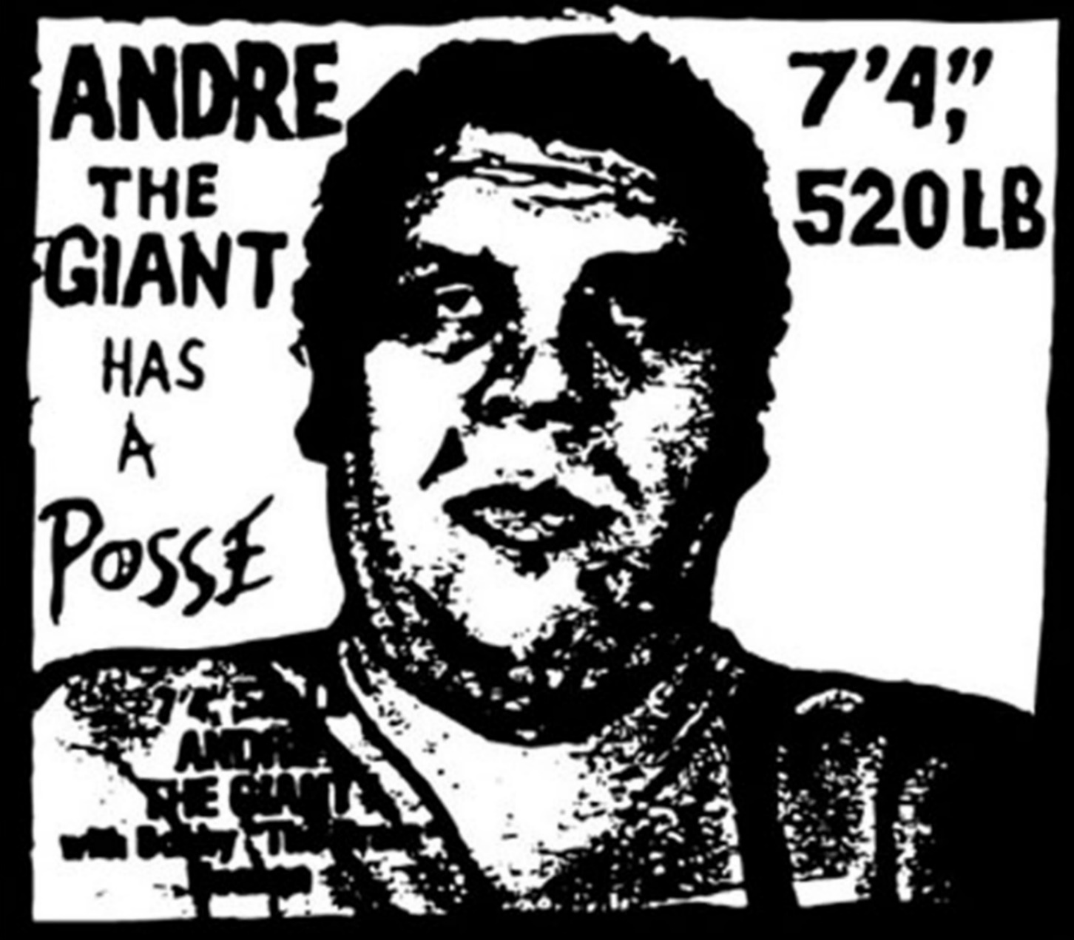
1) Andre the Giant Has A Posse
2) OBEY GIANT

Slide 5
TASK 1
Last time, you researched online information about
Andre the Giant Has A Posse
OBEY GIANT
and created a PowerPoint presentation…

Slide 6
In your powerpoint, you analysed…
How were both art works created?
What artistic process or METHODS were used?
What was the worldwide reaction to these art works?

Slide 7
Today:
We will ask ourselves a question:
How can we use the work of Shepard Fairey to inspire our own graffiti stencils?

Slide 8
TRACE THE FACE

Slide 9
1) PRINT OUT X 1 OBEY GIANT ON A4 PAPER.

Slide 10
2) STICK OBEY GIANT UP ON A WINDOW.
TIP: STICK IT AT A HEIGHT YOU CAN REACH!

Slide 11
3) STICK A BLANK A4 PIECE OF PAPER OR THIN CARD ON TOP OF OBEY GIANT…

Slide 12
4) CAREFULLY TRACE THE OUTLINE OF ANDRE THE GIANT’S FACIAL FEATURES.
TIP: SHADE IN THE DARK AREAS WITH A PENCIL OR A PEN SO YOU CAN SEE THE DETAILS CLEARLY.

Slide 13
5) DO NOT TRACE THE OBEY LETTERING!
INSTEAD, CREATE YOUR OWN 4 LETTER WORD TO PERSONALISE THIS ART WORK!
TIP: NO SWEAR WORDS…BE CREATIVE!

Slide 14
ONCE YOU HAVE MADE A CONFIDENT TRACED IMAGE WITH UNIQUE LETTERING…
KEEP YOUR ORIGINAL ART WORK SOMEWHERE SAFE!
WHEN WE RETURN TO SCHOOL AFTER THE COVID 19 ALL CLEAR, WE WILL CUT OUT THIS STENCIL USING ART SCAPELS ON CUTTING MATS AND MAKE A SPRAY PAINT ART WORK.
IMPORTANT: THIS STENCIL SHOULD BE COMPLETED WITH STAFF SUPERVISION AT SCHOOL…
DO NOT TRY AT HOME!

Slide 15
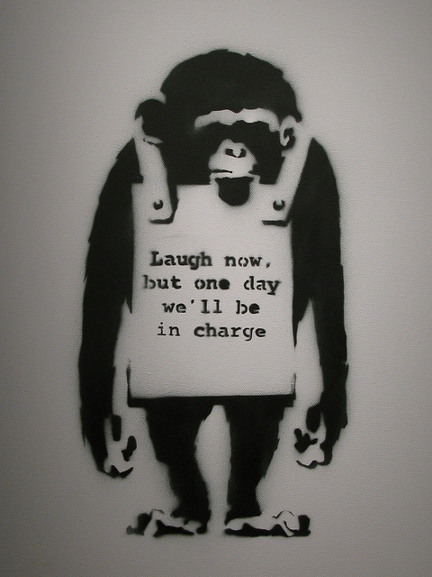
NEXT TIME: LAUGH NOW… BY BANKSY

Slide 16
clips
https://www.youtube.com/watch?v=9QrKhZ6aF_g&safe=active
https://www.youtube.com/watch?v=rcSBr4ZKmrQ&safe=active

