Slide 1
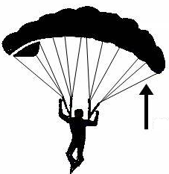
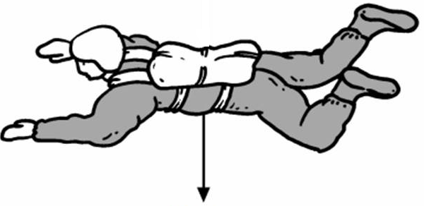
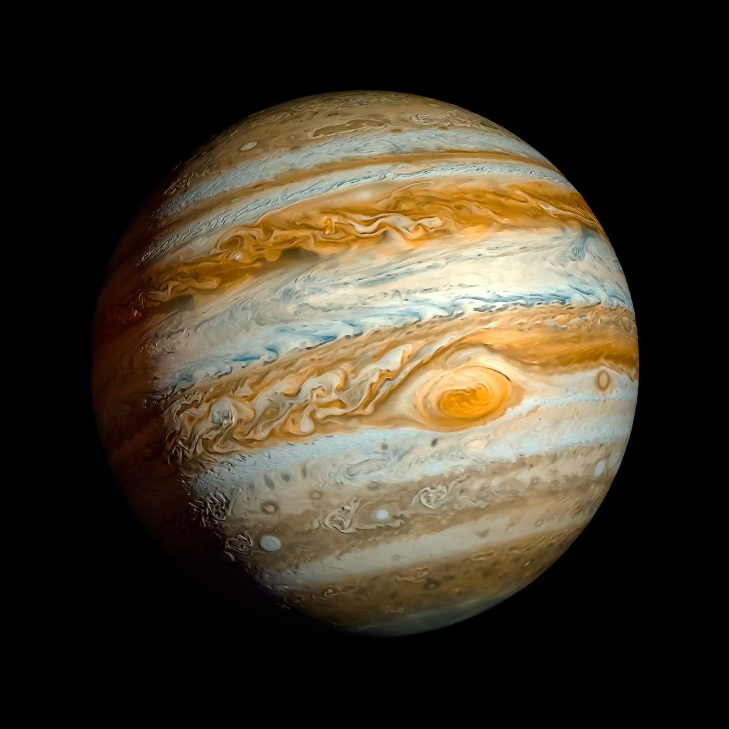
What forces are shown by these pictures?
On the diagram:
Write D where it is day
Write N where it is night
Draw an arrow to show what the Earth will do in 24 hours
This diagram shows when it is Summer in the Northern Hemisphere. Draw the Earth in Winter
Explain why this diagram shows our Summer
Name 2 contact forces:
Name 2 non-contact forces:
Complete the diagram to show how light from the Sun is reflected to Earth
Draw where the Moon would be during a Solar Eclipse
Space and
Gravity
What planet is this?
Would you weigh more, less or the same here?
Why?
Would your mass be more, less or the same here?
Why?
Fill in the blanks: Earth is the ……………………….. Planet from the Sun in our ………………………. …………………….. Which is found in a ……………………………. Called the Milky Way. The Sun is one of billions of …………………………….. In the Milky Way. When we look up into the night sky we sometimes see patterns of stars which we call ……………………………………………... (for example The Plough). Our galaxy is one of billions that are found in our …………………………………………….. Which was formed in a huge explosion nearly 14 billion years ago called the ………………………. …………………………….
My Very Easy Method Just Speeds Up Naming Planets. What is the order of the planets?
Why is this mnemonic not 100% accurate?
Come up with your own mnemonic:
Describe 3 ways that scientists use to learn more information about our solar system and beyond:

