Slide 1
STREET ART
YR 10 ART

Slide 2
LESSON 1
In this exciting project, we will learn about the work of Banksy and Sheperd Fairey.

Slide 3
WE WILL TRACE, CUT AND MAKE OUR OWN STENCILS AND SPRAY ART WORK!

Slide 4
BUT FIRST…
ARTIST RESEARCH

Slide 5
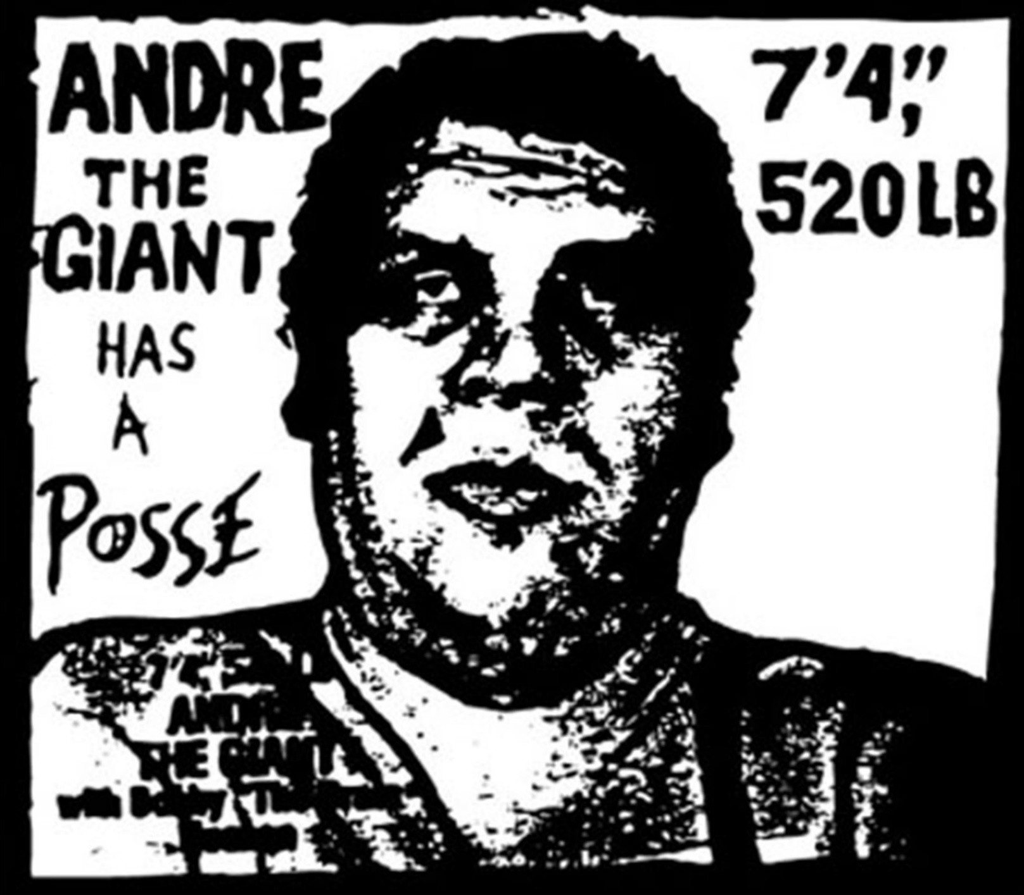
1) Andre the Giant Has A Posse

Slide 6
2)OBEY GIANT

Slide 7
TASK 1
Research online information about these two works by American Street Artist Sheperd Fairey and create a PowerPoint presentation.

Slide 8
TIP:
Don’t cut and paste the information you discover!
Instead, try and use your own words. Think about:
How were both art works created?
What was the artistic process or METHODS used?
What was the worldwide reaction to these art works?

Slide 9
NEXT TIME…
We will ask ourselves a question:
How can we use the work of Shepard Fairey to inspire our own graffiti stencils?

Slide 10
clips
https://www.youtube.com/watch?v=9QrKhZ6aF_g&safe=active
https://www.youtube.com/watch?v=rcSBr4ZKmrQ&safe=active

