Slide 1
THE FACE

Slide 2
LAST TIME
You created a self-portrait that had both realistic and stylised elements…

Slide 3
TODAY…
Using the drawing skills learnt so far, can you create a confident copy of Sam Beckett’s face?

Slide 4
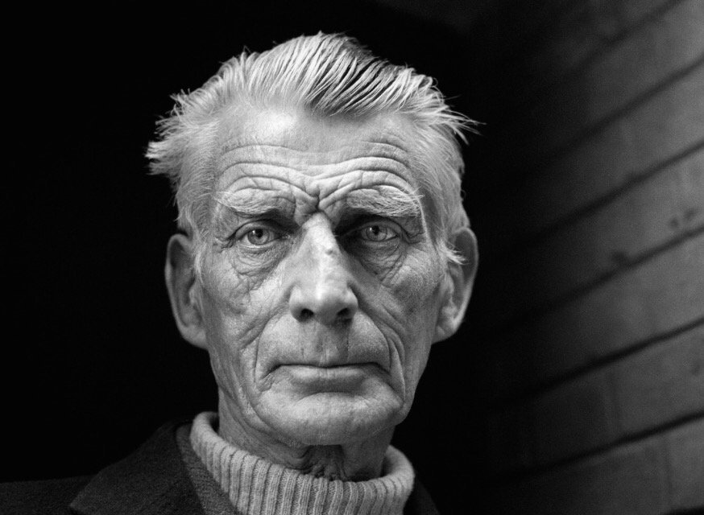

Slide 5
THINK ABOUT

Slide 6
PROPORTION
1. Egg shaped head (keep lines light!)
2. A line down, and a line across the face.
3. Carefully map out facial features (eyes, nose, mouth…)

Slide 7
LINE (THICK AND THIN AND BROKEN) Look carefully at the photograph of Sam Beckett. See how the light reveals his wrinkles? He looks like an old map! Try and describe these with thin and broken pencil lines…

Slide 8
SHADE
For the darker areas of your drawing, try using a teabag! This might seem a bit weird, but tea stain is a great way to build up areas of tone.
2. Don’t be shy! Really draw with your teabag around those darker areas (under the eyes, around the nose, in the hairline etc.)

Slide 9
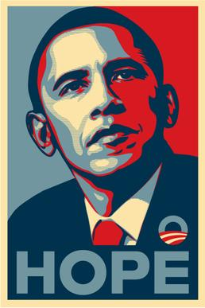
NEXT TIME: We return to STREET ART and the facial portraits of SHERERD FAIREY!

